Slide 1
ECONOMY OF CHINA

Slide 2
Chinese Inventions - Lets be Clear
Paper- 105 BC.
Movable Type printing – 960 AD, Tang Dynasty. Gutenberg – 1440.
Gunpowder – 1000 AD. Spread to Europe by the Mongols.
Compass 1100 AD… Initially as a Feng Shui Tool, not as a Navigational aid.
Alcohol – 2000 BC.
Mechanical clock – 725 AD.
Tea Production 2737 BC.

Slide 3
Silk Production – 6000 BC .
Umbrella- 1500 BC.
Acupuncture and surgery- 2300 BC
Iron Smelting 1050 BC.
Porcelain.
Earthquake detector.
Rocket – 228 AD.
Bronze- 1700 BC.
Kite – 1000 BC.
Farming Innovations- Row Crop (600 BC), Seed Drill,
Tooth Brush .
Paper Money

Slide 4
Du Jiang Yan. (256 BC by Qin)
Still in Use.
https://www.youtube.com/watch?v=KKkwb00MeEM

Slide 5
Joseph Needham’s Science and Civilization in China.
Still in Progress.
https://www.dailymotion.com/video/xgl7iw

Slide 6
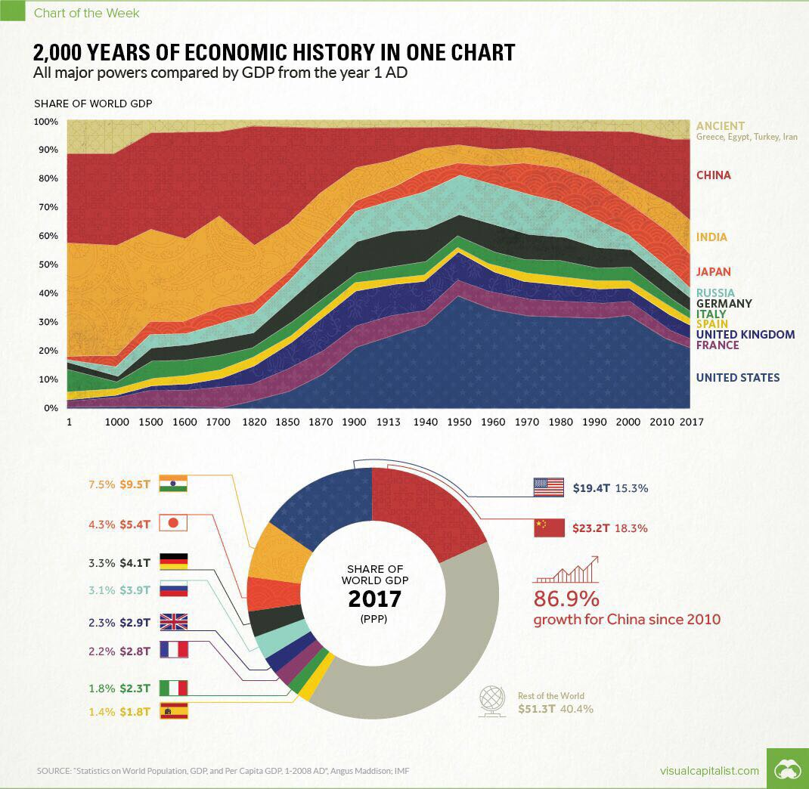

Slide 7
DATA POINTS
Socialist Market Economy.
Largest by PPP and Second Largest ($ 14T) otherwise.
GDP Per Capita is 73rd. (Less Macau, which is amongst the top)
Largest Natural Resources (US $ 23 T).
Huge Banking Sector
$40 T in assets.
$28 T in Deposits.
4th in Inward FDI, 11th in Outward FDI.
129 of the 500 largest Companies in the World are Head Quartered in China.

Slide 8
Largest Manufacturing Economy.
Second Largest Importer,
Fastest Growing Consumer Market.
31st on Ease of Doing Business.
28th on Global Competitiveness Report
Provinces in the Coast are far more developed and industrialized.

Slide 9
Misunderstanding of China
https://www.youtube.com/watch?v=zY2iPePjXAU
While Political freedoms haven’t increased, personal freedoms have expanded vastly.
Most Pro business Govt in the World.
Contributes more to Global growth than US, Europe and Japan Combined.

Slide 10
RISE OF CHINA
Fastest Growing Country for several decades. Above 9%. 6 % currently.
Increased Competitiveness in manufacturing.
Shift from Public to Private Ownership
% of Population living below US $ 1 per day has dropped from 60% in 1980 to less than 13% in 2003 to less than 5% in 2010 and barely a handful today.
It is hugely attributable to massive spending in Infra, about 15% of GDP.
Tops in Railway and roads and they were behind us till recently.
High speed rail exceeds rest of the world put together.

Slide 11
Consumes 50% of almost every raw material in the world. Steel, Cement, Copper etc.
Factory of the World.
Projects are huge in Variety and Scope.
Rate of Construction.
Very Hard Working People.

Slide 12
FOCUS

Slide 13
Please Read the Book – Factory Girls by Leslie Chang
https://www.youtube.com/watch?v=Jk-xqPKOxl4

Slide 14
China’s Economy
7.2% of World Trade.
Attracted over USD 1 T worth of FDI since 1978.
Largest Foreign exchange Reserves of USD 3 T , while dropping recently, remains thrice anyone else.

Slide 15
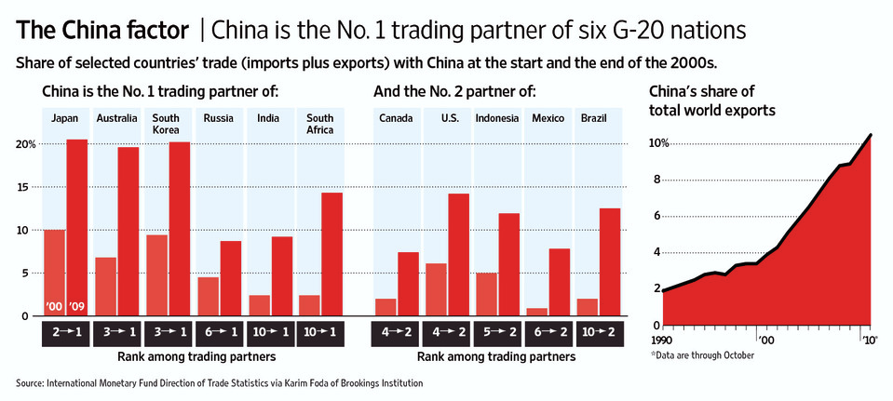
THE CENTRALITY OF TRADE IN CHINA’S RISE.

Slide 16
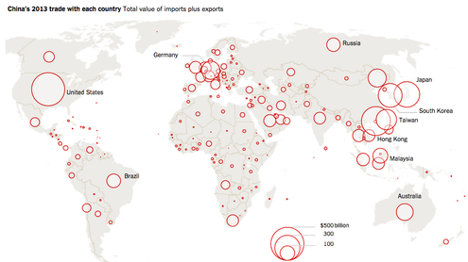

Slide 17
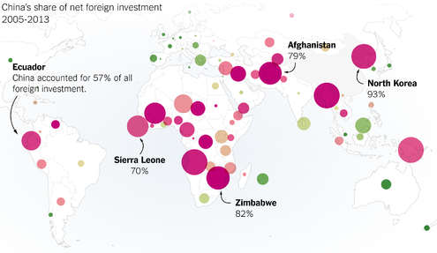

Slide 18
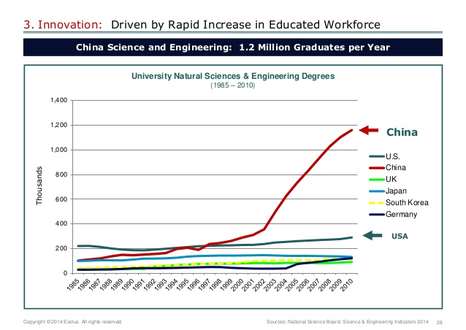

Slide 19
Exports maintain domestic social order by providing a significant source of jobs right away, rather than in some future scenario involving the rebalancing of their work forces.
For China, whose Communist Party was shaped by the rising up of the unemployed in Shanghai in 1927, maintaining full employment is a bulwark in defense of the government.
China looks at unemployment not only in terms of economics, but also in terms of social stability and governmental survival. Therefore, exports are not simply a number, but the foundation of the current “social stability”

Slide 20
All Sorts of freedom to Employers, none to Employees.
Entrepreneurship is encouraged, Can even get Party Membership.
Advocates for Social Justice and Rights of Labour face every difficulty and No Question of Recognition by the Party
Socialism with Chinese Characteristics

Slide 21
ECONOMICS
CHINA IS AN “ALMOST” DEVELOPED COUNTRY. THAT IS THE UNCOMFORTABLE TRUTH. HOWEVER IT IS NOT A WELFARE STATE.
THE PARTY IS SEEN TO HAVE DELIVERED THE GOODS.
POOR PEOPLE, WHAT POOR PEOPLE?? BUT 1% CONTROL 1/3 WEALTH.
UNBALANCED DEVELOPMENT. UNHEALTHY STATE OF FINANCIAL SYSTEM.

Slide 22
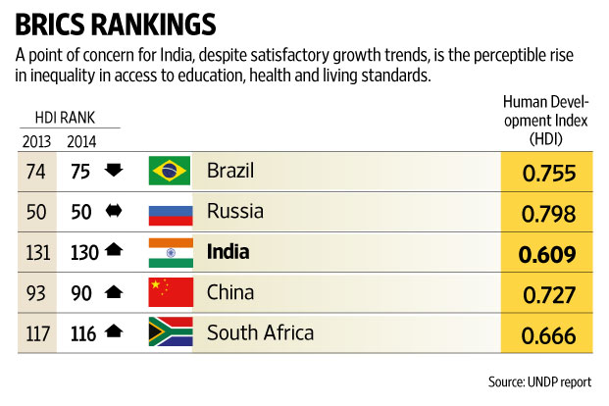
Human Development Index : 2015
86 as of 2017

Slide 24
WILL THEY ACHIEVE THEIR ECO GOALS?

Slide 25
CHALLENGES
Difficult to maintain High Growth
Shrinking low end export Sector.
Deflated Construction Bubble.
Only Solution
Improve High Tech Exports.
Improve Domestic Consumption.

Slide 26
UNPREDICTABLE SITUATION
Party does not like Unpredictability.
Japan is contesting China.
Money flowing Outwards. Mainly in Real estate.
China is reacting to Change as always, turning Inwards…. Zheng He
Halved by 50% since 2018.

Slide 27
INTERNATIONALIZATION OF THE RENMINBI
Getting Stronger and Stronger (the current devaluation is a tactical response to the Trade War).
Founding of AIIB.
Renminbi Settling.
Iran Push since this year. (US Sanctions Not so threatening anymore)

Slide 28
One big Problem- Unreliable Numbers
Liaoning Govt overstated GDP by 20%. (2011-14)
Tianjin by 33%. (2016).
Bao ba (Protect Eight).
Li Ke Qiang Index
Numbers are man made.
To be used for ref only.
Electricity Consumption, Cargo Volume and Bank Loan disbursement data.

Slide 29
THE PROPERTY BUBBLE
2009 CHINA LAUNCHED A $ 600B(1 T?) STIMULUS. TO SOEs.
MONEY FROM NON STATE ENTERPRISES.
INFRASTRUCTURE, REAL ESTATE. TRIANGULAR LOANS.
50 % TAX REVENUES COME FROM SALE OF LAND. COLLUSION.
LAND SALES INCREASED . BUT MATCHING APARTMENTS NOT SOLD. INFACT LESSER DUE TO CURBS.
TOTAL FLOOR AREA IN URBAN AREAS 43 B SQ M, OR 53.75 SQ M PER PERSON (EVEN IF 800M ARE IN CITIES). THAT MEANS A FAMILY OF 3 HAS 160 SQ M, ACTUAL MAY BE LESS THAN HALF. OVERSUPPLY.
PROBLEM ALSO THAT PROPERTY USED AS COLLATERAL FOR VIRTUALLY ALL FORMS OF BORROWING.

Slide 30
IMPACT
Falling real estate prices impact everyone.
The people contributing to the coffers are exporters…. Already under squeeze.
SME shut down wave. Wenzhou.
23% of loans sp by municipalities is total loss, addl 50% “at risk”. About $1 Trillion of Loans transferred to SPVs.
Answer- more capital controls, prevent flight.
Inflation.

Slide 31
CURRENT ACCOUNT SURPLUS VANISHING
In 2007 China’s Current Account Surplus was 10% of GDP.
Led to global savings glut.
But the Current account Surplus has shrunk to 2.8% of GDP. Reasons
Exchange Rate has risen.
Cost of her imports have risen relative to prices of her exports.
China’s Own Spending has risen.
Savings rate has dropped.

Slide 32
China – looking Ahead
https://www.youtube.com/watch?v=zY2iPePjXAU

Slide 33
POLLUTION IN CHINA
Industrial pollution.
Affects safety of Crops, livestock and marine life.
Electronic Waste.
Returning containers.
Over Extraction.
No Stubble burning.
Impact of Desert Winds and increased Desertification.

Slide 34
Govt Steps
Examples of Liang Ma He, Energy Conservation.
Reduce Coal consumption. Phenomenal Investment of $ 140-160 B. Renewable, Nuclear etc
Banned Import of Waste.
Focus on big cities. Average AQI 35 in Beijing, to minimum of 19 on 01 Oct 2019.

Slide 35
US - CHINA TRADE WAR
US Imports – $ 3.1 T from all over World (17% from China)
US Exports -- $ 2.5 T ( 4.8% to China)
Deficit – $ 621 Billion ( $ 419 Billion with China- 67%)
1.13 T in T Bills (Used to be 1.3 T). Tool of Coercion. 28% of all debt.
Made in China 2025 and plans to become the Superpower.
Pressuring Companies
300 b subsidies.
Foreign Outbound Investment in Hi Tech Companies.
SOE to lead all this.
Forcing Trade/ IPR .
It is all about Power and Politics.

Slide 36
Goal is to change China’s unfair Trade practices.
Tit for Tat Tariffs. Virtually everything is tariffed.
Hurting US Companies too.
Farmers taking a hit. Short term pain vs Long term gain.
What if China sells the Debt?
.... Crash.
Can we increase our share of the pie?

Slide 37
Thank you

Slide 38
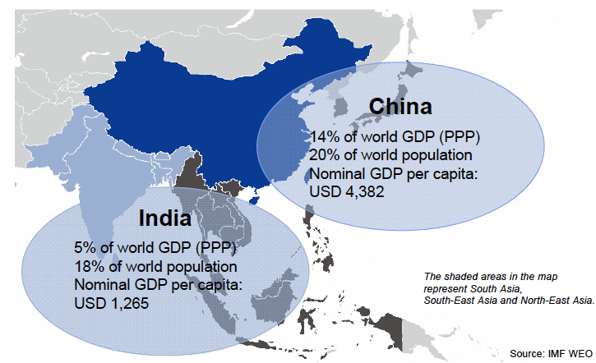
ECONOMICS :THE BASICS

